Slide 1
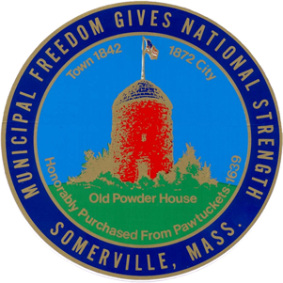
Powder House Blvd Traffic Safety plan
City of Somerville Transportation and Infrastructure Division April 2, 2019

Slide 2
Plan Overview
Every action detailed in this plan aims to increase pedestrian and cyclist safety on Powder House Boulevard as well as the safety of all participants in traffic including motorists. When we plan to protect the most vulnerable, everyone is safer.
Each action builds upon earlier safety measures and traffic calming improvements made to the Boulevard in recent years.
Each feature works both independently to calm traffic and increase safety and as part of an overall system of traffic calming.
Overall efforts combine both existing and emerging best practices that are well tested for their traffic calming efficacy.

Slide 3
Timing Overview
Three series of actions / improvements will take place:
Series 1 during the next 6 to 8 weeks (starting April 1) is expected to be completed in April and May 2019.
Series 2 during the next 6 months (starting April 1) is expected to be completed in April to September 2019.
Series 3 is expected to be completed in Fall 2019 / Spring 2020.
All times are current best estimates. We are committed to making every possible effort to maintain this schedule, but circumstances outside our control could impact timing.

Slide 4
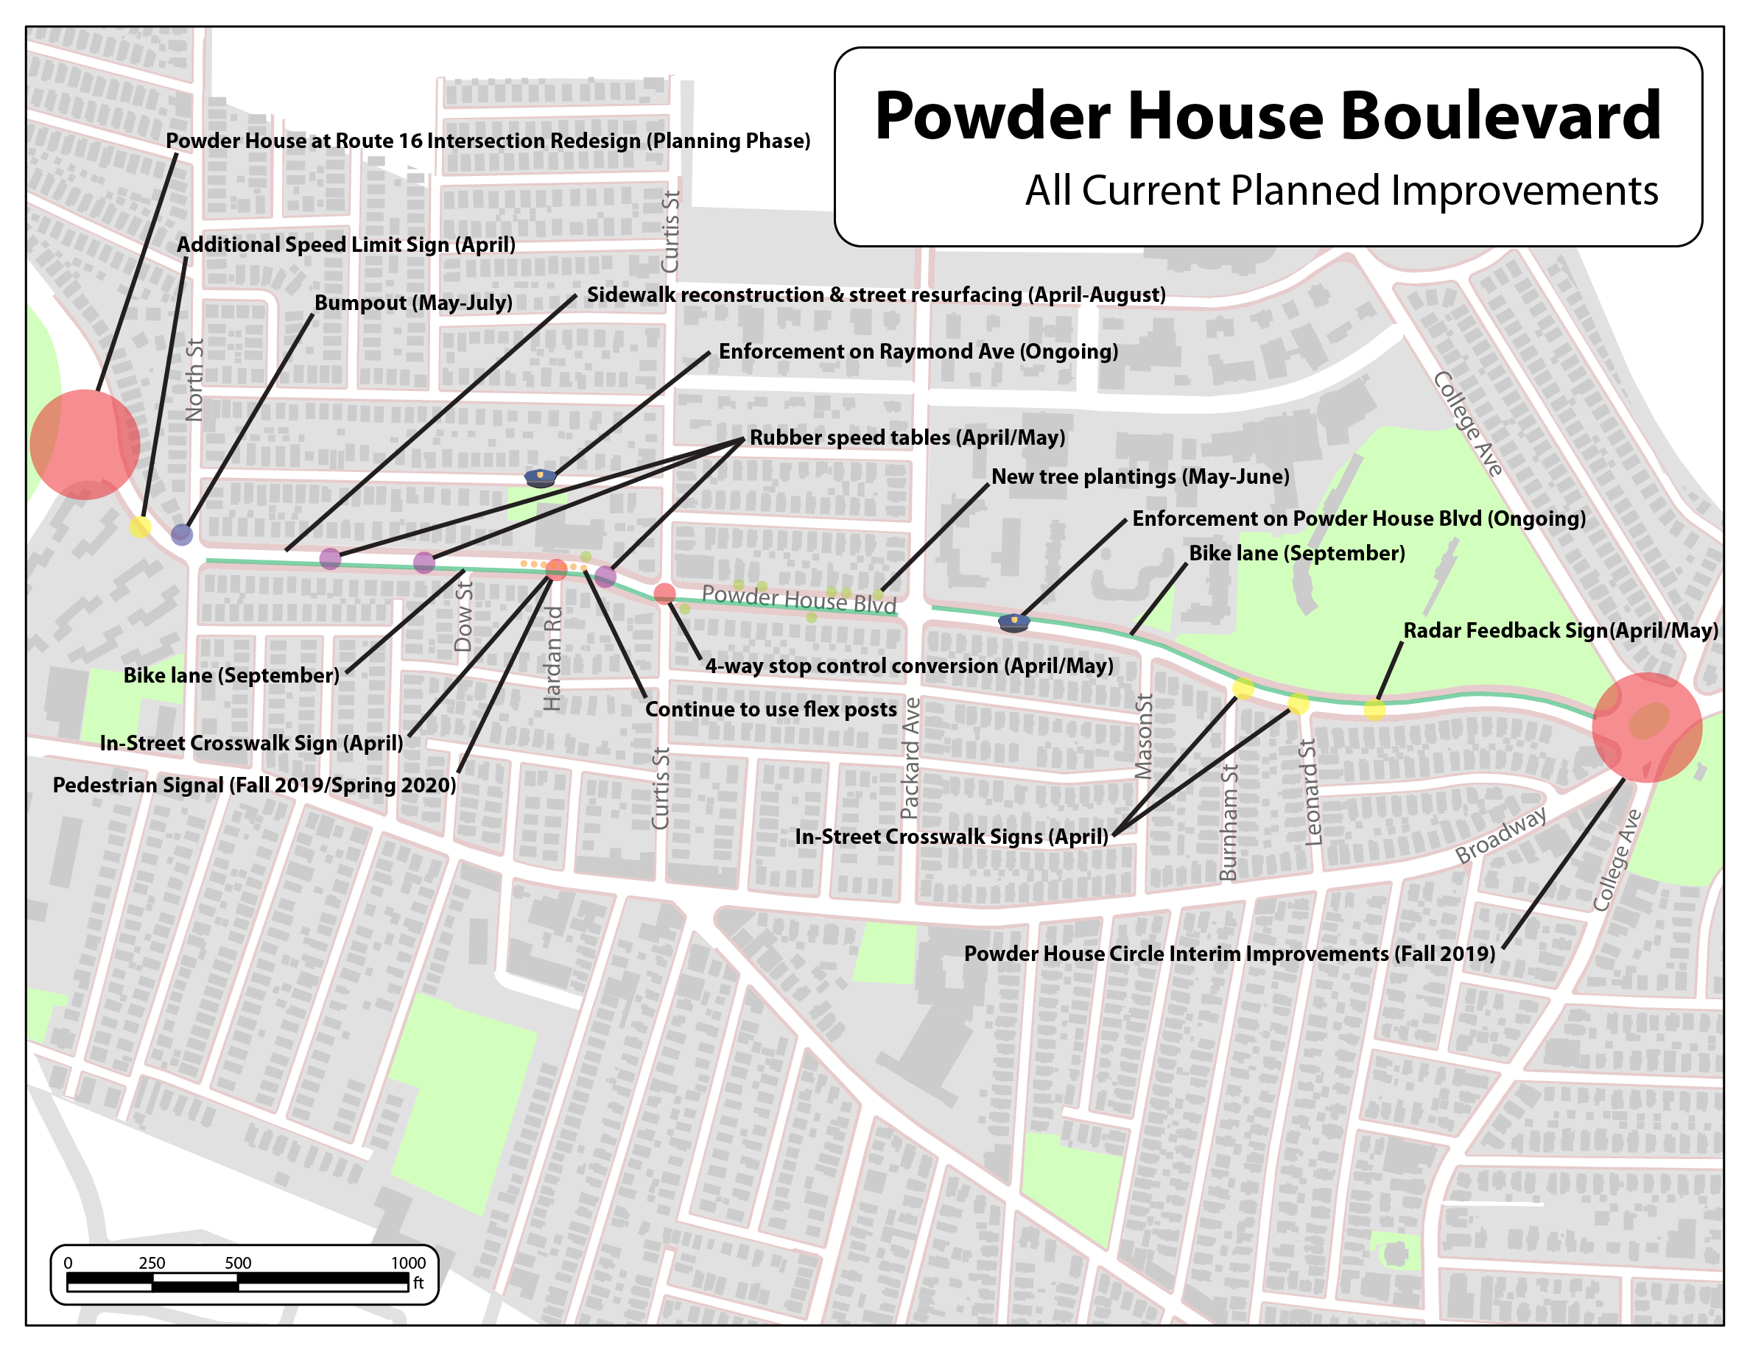
Map Overview (please zoom in to read)

Slide 5
Series I: April & May 2019
During this 6-8 week period starting April 1, both permanent measures, such as additional radar feedback signs, as well as interim measures, such as rubber speed tables that can be installed prior to the completion of construction, will be undertaken.
Rubber Speed Tables: Install 3 seasonal rubber speed tables between Curtis St and North St
4-Way Stop at Curtis: Convert intersection of Powder House Blvd and Curtis St to 4-way stop control to reduce drivers speeding up to make yellow lights and reduce delay for pedestrians
Radar Feedback: Install additional radar feedback signs between Powder House Circle and Packard Ave
Speed signage: Add second 25 mph speed limit sign near Rte. 16 entrance to PHB
Replace Movable Mid-Walk Signage: Install bolted mid-cross-walk pedestrian flex signs
Flex posts: Ongoing maintenance of installation
Enforcement: Heavy SPD presence on Blvd., crossing guard at Raymond, SPD one-way enforcement at Raymond

Slide 6
Series I: Map

Slide 7
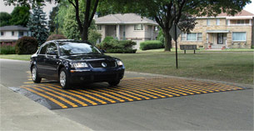
Understanding Rubber Speed Tables
The speed tables here refer to raised features that span the width of the road (38 feet), extend 14 feet in the direction of travel, and are 3 inches high. The resulting change in elevation is expected to slow vehicles to ~20 mph.
38 ft w x 14 ft l x 3 in h

Slide 8
Speed Tables: Part of a 3-Part Solution
Rubber speed tables (two west of Hardan and one east) will be installed as part of three inter-related measures designed to work as a whole to enhance safety in front of the West Somerville Neighborhood School at Hardan Road as well as along the full North-to-Curtis section of the Blvd. The three measures are speed tables, a HAWK signal at Hardan, and a 4-way stop at Curtis (to replace the signalized intersection).
Speed tables slow traffic. A multi-speed-table installation between Curtis St and North St, coupled with the coming 4-way stop at Curtis and a HAWK signal at the School crosswalks at Hardan, rather than one larger raised table at the crosswalk alone, is the recommended configuration to best calm traffic at the School crosswalks at Hardan Road.
This configuration is designed to slow traffic well before it reaches the School rather than only once it’s at the crosswalk. Permanent tables (usually made of asphalt) will follow the completion of road construction. Overall, these three measures are designed to achieve a slower driving pattern between North St and Curtis St, as well as protection for the school crosswalks at Hardan Rd.
What:
Why:

Slide 9
Series II: April to Sept. 2019
Bump Out: Install a curb extension or “bump out” on the northwest corner of the North St intersection to slow traffic, force slower turns, and shorten the distance pedestrians must travel to cross the Blvd.
Sidewalks: Finish sidewalk work (mostly between Curtis St and Alewife Brook Pkwy). This includes replacing curbing, ramps, sidewalks, and installation of the bump out at North St.
Paving: Repave street from North to Mason/Burnham (August/September)
Markings: Put down pavement markings on new pavement (September)
Road Diet/ Bike Lanes: Mark new bike facilities according to community preference to enhance bicycle safety and calm traffic by narrowing the travel lanes (September)
Enforcement: Heavy SPD speeding enforcement ongoing until further notice
Trees: Plant seven trees between Curtis & Packard to slow traffic (via visual friction) and maintain visual appeal of Blvd. (Spring 2019)

Slide 10
Series II: Map

Slide 11
North Street Bump Out
Bump-Out
Existing
Proposed for 2019
Image: 70-foot crosswalk becomes ~30-foot crosswalk
Next steps: Engineering design in progress; Construction Spring/Summer ‘19

Slide 12
North Street to Remain Signalized
After a thorough review by our traffic engineering consultants Toole Design, they recommended that the North Street intersection remain signalized rather than instituting a 4-way stop as will be done at Curtis.
Due to the high volume of traffic coming off Route 16, but short queuing space, their analysis of the data indicates that a risk of unsafe backups onto Route 16 would increase with the introduction of a 4-way stop at North.
North Street improvements will instead include the addition of a second 25 mph sign and the large North St bump out.

Slide 13
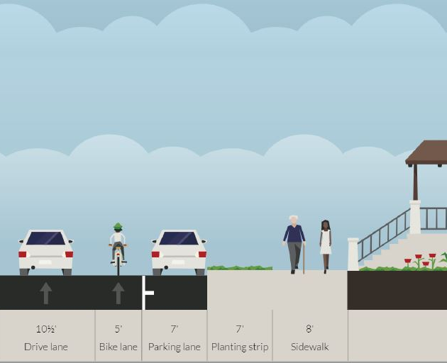
Understanding Bike Options
Option 1: 1-Way Bike Lane
Option 2: 2-Way Bike Path
The City has an existing plan to install one-way bike lanes on the Boulevard. The Somerville Bicycle Committee and residents have expressed strong interest in discussing the option of a protected two-way bike path. The two-way option would be safest with a 4-way stop at Curtis, and now that the City’s consultants have recommended the 4-way stop, the two-way facility becomes a more feasible option.

Slide 14
Bike Lane / Path Process
The City would like to support community discussion on the trade-offs involved with the two bicycle options. Cyclist and overall pedestrian safety is expected to improve with a protected two-way path. Parking, however, would be lost on one side of the road, which could have unintended impacts on pedestrian crossing behavior.
Bikes lanes can also serve as a traffic calming measure. They slow traffic by narrowing the vehicle travel lanes and creating visual friction. To avoid any delay in the installation of this measure, community discussions must be completed by the end of August.
Once a decision is reached, the chosen option will be implemented in the fall of 2019. Neither option will require any changes to the existing road improvement project.

Slide 15
Series III: Fall 2019/Spring 2020
Pedestrian-activated HAWK signal at WSN School:
Design, fund, contract, and install pedestrian activated HAWK signal as additional traffic control measure for pedestrians at Hardan Rd. in front of the School
This portion of project is dependent on success of the 4-way stop at Curtis St.
Permanent speed tables:
Design, fund, contract, and install permanent traffic calming measures between Curtis St and North St
This portion of project dependent on success and longer-term strategy around both rubber and asphalt speed tables.
Powder Circle interim improvements:
To make the rotary more like a true rotary and increase safety: Narrow travel lanes with paint and flex posts, where possible reduce to single lane of entry and exit, add bike lanes
Grass:
Hydro-seeding in the planting strip will be one of the last items to be completed and is dependent on optimal time for laying down seed. If the project remains on schedule, this could potentially be fall 2019. Grass seeding will be carried out the by contractor completing the road upgrade.

Slide 16
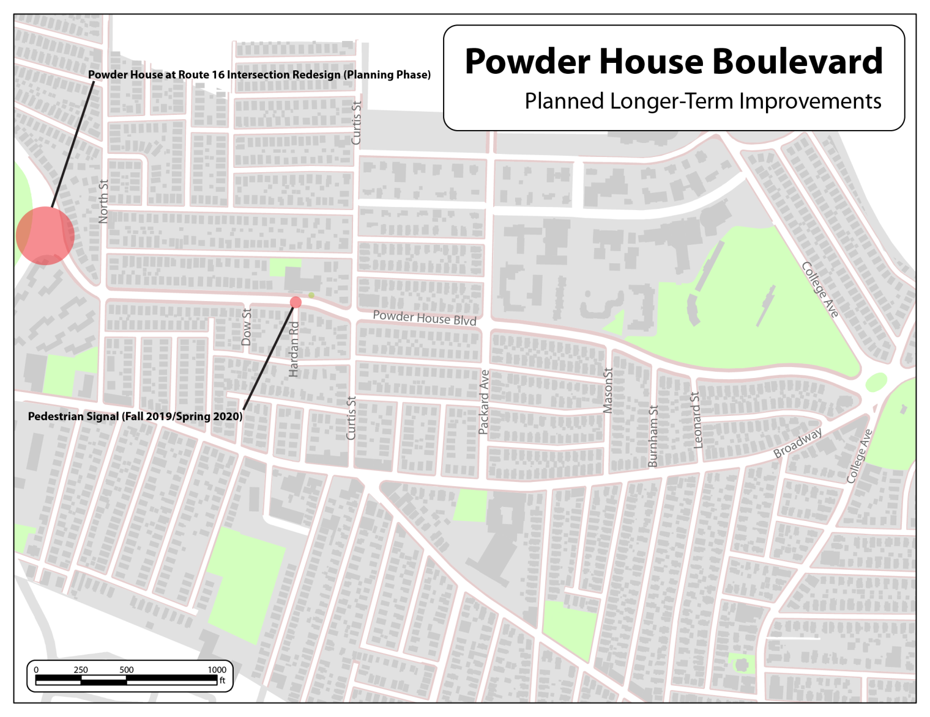
Series III: Map

Slide 17
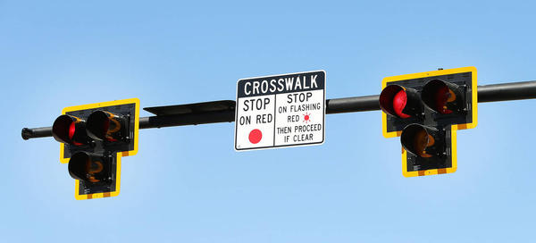
Understanding the HAWK Signal
HAWK signals are pedestrian-activated stop lights above the center of the road that can stop two-way traffic. HAWK stands for High- Intensity Activated cross WalK.

Slide 18
HAWK signals use a series of signals to slow traffic (flashing and solid yellow lights) and then stop traffic (flashing and solid red lights) before they signal for pedestrians to cross.
At appropriate locations, HAWK signals can significantly reduce pedestrian crashes overall, including severe crashes, and they are especially well-suited to mid-block crossings on high-volume roadways such as in front of the West Somerville Neighborhood School.

Slide 19
The HAWK signal requires a 4-way stop at Curtis
Once the 4-way stop and the rubber speed tables go in, their safety impacts and effectiveness will be evaluated. Results of that evaluation will determine next steps.
OPTION 1: 4-way stop + HAWK + year-round speed tables: If the 4-way stop at Curtis is effective, the HAWK can then be installed at Hardan Rd because it will be safe for the HAWK to function on-demand. This means that when a pedestrian pushes the button to cross, the signal will immediately begin to flash and cars will begin slowing down. The year-round speed tables will be installed at locations that will best support these two features.
OPTION 2: Signals + speed tables + flashing beacon + possible table/raised crosswalk: If the 4-way stop is not as effective as traffic lights, the lights will be unbagged, and the HAWK will have to be reconsidered. With a full signal at Curtis St, the HAWK would have to be synchronized to prevent traffic backups into the Curtis St intersection. This would mean that pedestrians would have to wait longer to get the walk signal at Hardan Rd, increasing the likelihood of dangerous crossing maneuvers. In this case, the speed table configuration at/around Hardan Rd would change and the Rapid Flashing Pedestrian Beacon would be retained. That change could include a raised crosswalk/speed table at the school.

Slide 20
HAWK Installation Schedule
By Mid-June 2019: Results of Curtis 4-way stop
Before the City procures a HAWK signal designer/installer, it must first verify that the 4-way stop at Curtis is an effective treatment for that intersection.
Data collection and evaluation will be sufficient and properly analyzed by mid-June
By Sep. 2019: Design HAWK to location requirements
HAWK signals must meet all design, electrical, and installation needs of the designated intersection
This process is estimated at 8-12 weeks
By Jan. 2019: Procure HAWK designer/Installer
Municipalities must adhere to strict procurement laws and regulations, meaning a bid process is required to hire a designer/installer
This process is expected to take 90 to 105 days
By May-June 2020: Purchase HAWK, sidewalk prep, install
Once the contract is executed, required equipment must be purchased, sidewalk prep to accommodate installation must be completed, and all electrical must be prepared. Then installation can proceed according to proper standards and specifications.
This process is estimated to take 3-6 months.
We too would like to see the best HAWK option go in as quickly as possible. But to be clear, while we will strive to maintain -- or move more quickly than -- this schedule, factors beyond our control could affect timing.

Slide 21
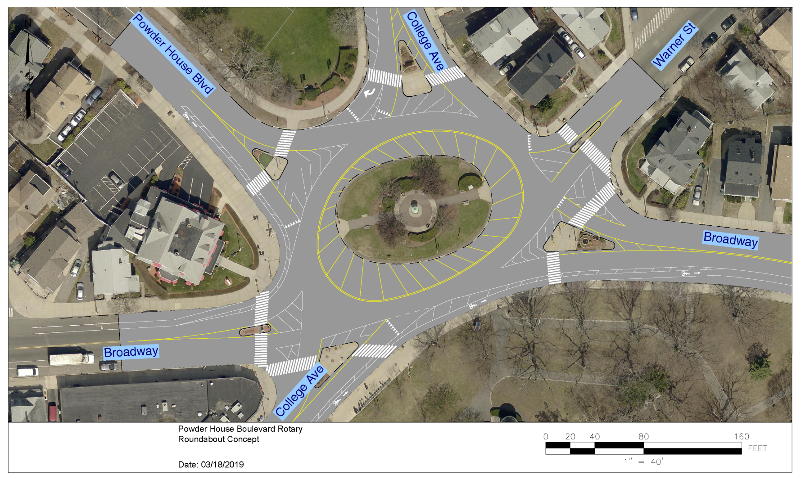
Fall 2019: Powder House Rotary
Image: Paint and Flex Post Treatment at Rotary
Traffic calming benefit: Motor vehicles are channeled and slowed

Slide 22
A Closer Look:
Crosswalks
Signage
Enforcement

Slide 23
Crosswalks: Traffic & Parking Dept.
Crosswalk paint refreshing:
High-visibility crosswalk paint refreshing is carried out in warm weather seasons (spring, summer, fall) on an ongoing basis citywide by Traffic & Parking.
In spring 2019, all Powder House Boulevard crosswalks from North St. to the Rotary will be assessed and repainted as per industry standards and best practices.
Mid-Crosswalk “Yield for Pedestrians in Crosswalk” Signs:
The flexible “Yield…” signs posted mid-crosswalk are known as Pedestrian Impact Recovery Systems (PIRS).
Currently, PIRS require continual replacement and readjustment resulting inevitably in some periods in which they are not optimally placed after being struck by vehicles.
Traffic & Parking has recently piloted newer, vehicle-safe, bolt-in-place PIRS at several locations across the city. They have performed well. These bolt-in-place PIRS are on order for the crosswalks along the Boulevard and will be installed this spring (2019).

Slide 24
Signage: Traffic & Parking Dept.
Radar feedback signs: “Your Speed Is” signs:
Traffic and Parking currently has two additional radar feedback signs on order for the Boulevard.
The new signs will be placed on the Boulevard between Packard Ave and Powder House Circle on the eastbound and westbound sides.
These signs also collect traffic counts that will inform further traffic calming efforts.
Slowing vehicle speeds along the eastern section of the Blvd. helps prepare drivers to maintain lower speeds on the western section as well.
No Trucking:
Background: To restrict trucks from any roadway, a MassDot granted restriction is required. Powder House Boulevard does not have, and has never had, a trucking restriction.
Status: The Blvd. has a legacy “No Trucks” sign at the entrance to the Boulevard at the Powder House Rotary. The City has left this legacy sign in place, which has the effect of reducing truck usage, but it cannot place additional signs.

Slide 25
Signage: Traffic & Parking Dept.
Sign height review and pruning:
The Traffic and Parking department has recently re-reviewed all signage heights along the Boulevard and found all to be within regulation heights.
Sign visibility and identification of pruning needs are an ongoing endeavor of the department. All signs on the Boulevard were assessed for pruning needs in March. Once the trees leaf out, they will be reassessed and any pruning needs will be addressed. Pruning needs can also be reported by residents to 311.
25 mph signage (done):
Currently the City posts 25 mph signs at city entrances.
The Traffic and Parking department has installed a second sign near the Route 16 entrance to the Boulevard to ensure visibility for traffic entering the Blvd. via both the northbound and southbound lanes on Route 16.

Slide 26
Enforcement: Somerville Police Dept.
Speeding Enforcement:
SPD continues to keep the full length of Powder House Blvd. as its top priority for speed enforcement in the city. They have maintained a constant and significant presence both mornings and evenings.
Enforcement activity is focused on speeding vehicles, but officers who observe unsafe pedestrian behavior are conducting educational outreach to pedestrians as well.
Enforcement will continue until further notice.

Slide 27
Raymond Ave.: Somerville Police Dept.
Raymond Ave. One-Way Enforcement:
Officers have been assigned to conduct one-way enforcement, and SPD will continue to keep Raymond Ave. at Curtis on their list for regular enforcement during pickup and drop-off until further notice.
Raymond Ave. Pickup and Drop-off:
As a pilot, a crossing guard is currently assigned to this location. After this pilot period (potentially to the end of the school year), the assignment will be reassessed.
Currently there are six crossing guards assigned to West Somerville Neighborhood School walking routes. It is a best practice to assign crossing guards to locations where a sufficient number of unaccompanied young children regularly cross.
A head count of unaccompanied students crossing the roadway at the Raymond Ave. entrance did not reveal a use level that would warrant the assignment of a crossing guard at this location. However, a pilot period will allow a longer data-gathering interval to verify this.

Slide 28
Lighting: DPW Lights and Lines
Lighting review and adjustment
All lighting along the Blvd. was reviewed earlier this year and any needed adjustments to maximize safety were made.
Lighting review will continue on an ongoing basis as it does citywide.

Slide 29
Education & Outreach
W. S. Neighborhood School
Vision Zero
City Staff will coordinate with the Somerville Public Schools on additional traffic safety outreach and education for both students and parents
The City’s ongoing efforts to promote traffic safety for all participants will expand with Vision Zero. As part of Vision Zero efforts, additional educational materials and outreach for traffic safety citywide will be developed and will be broadly distributed broadly via print and digital means.

Slide 30
Legislative Goals: Vision Zero Funding
Mayor Curtatone set to make substantial Vision Zero funding request.
Somerville has made tremendous progress on its mobility shift goals as outlined in SomerVision. Through targeted investment in new infrastructure ranging from significantly improved crosswalk markings and access, lighting, lowered citywide speed limits, bicycle lanes and tracks, and education and outreach, Somerville has been recognized as one of the most walkable and bikeable cities in the U.S.
As that shift has progressed, the City has consistently and steadily increased staffing and funding to address related infrastructure, enforcement, and traffic calming needs. The needs are however great as we work to transform decades of car-centric infrastructure to meet the safety needs of growing pedestrian and cyclist use.
Continuing this effort, the Mayor will be submitting a substantial funding request for Vision Zero to the City Council and any related staffing requests will be included in the FY2020 budget being submitted this Spring 2019. The hope is for full support of this needed investment in traffic calming and safety.

Slide 31
Legislative Goals: Traffic Cameras
Mayor Curtatone to pursue red light / speed camera
law change – again
In Massachusetts, red light and speed cameras are illegal.
Mayor Curtatone helped champion an effort in the late 2000’s to request that the State Legislature allow red light and speed cameras as a traffic calming measure in the Commonwealth.
That effort was defeated. Thoughtful discussion at the time focused on privacy rights.
With the increasing mobility shift toward walking and biking, traffic calming is increasingly needed. Meanwhile, privacy issues remain important to consider.
Mayor Curtatone is committed to working with his fellow elected officials, privacy and traffic safety advocates, and the community to develop and call for legislation that balances the important public safety benefits of traffic enforcement cameras with carefully considered privacy protections.

Slide 32
Trees: For traffic calming & appeal
Trees do more than add appeal.
They help calm traffic by creating visual friction.
10 Trees Planted in 2018
7 Trees Scheduled for Spring 2019
1 Tree Scheduled for Fall 2019
Tree selection
A mix of site-appropriate tree species will be selected that are best suited to the location for survivability, visual appeal, and growth habits.
Details
At the direction of the City Arborist, more than 10 trees were planted along Powder House Blvd. last year.
`The City Arborist reviewed available planting sites between Packard and Curtis and identified seven sites that appear suitable for planting. Pending DigSafe approval, the Arborist will oversee tree planting on these sites during the spring 2019 planting season.
In addition, the Arborist identified at least one suitable planting location on the Curtis-to-North St. section. To provide the best chance of survival, this tree, and other new trees along this section, will be planted after sidewalk reconstruction is complete during the fall 2019 planting season.

Slide 33
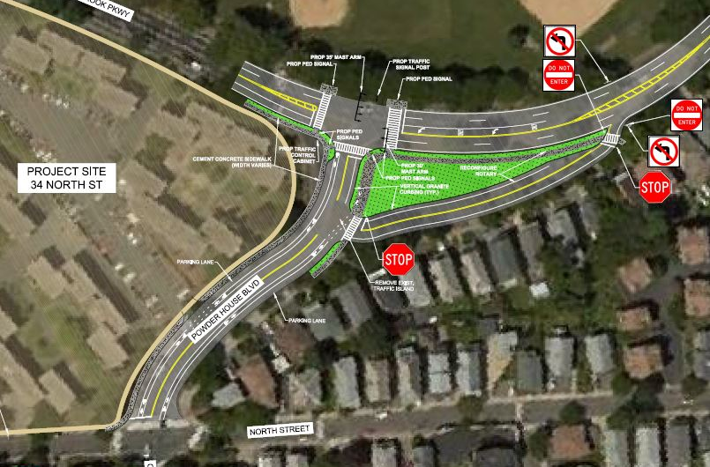
Looking ahead: Route 16 option
Long-term vision for converting high-speed rotary to signalized intersection to calm traffic entering the Blvd. from Route 16.

Slide 34
Looking back: Previous improvements
As noted, the above improvements and actions all build on previous traffic calming efforts undertaken in recent years.
Prior improvements include sidewalk bump outs, improved crosswalk markings, new crosswalks, reflective mid-crosswalk signs, a pedestrian-activated Rapid Flashing Beacon at Hardan Road, reflective strips, the flashing 4-way stop at Packard installed in collaboration with Tufts University, and the decision to lower the citywide speed limit in 2016 to 25 mph.
Those improvements have produced measurable results in traffic calming, including a 20 percent reduction in speeding in front of the School. But clearly there is more to do. We thank the community for their input as we work toward Vision Zero.

Slide 35
Public Meetings & Neighborhood Office Hours
Neighborhood Office Hours
Wednesday, April 10, 6-8 p.m., West Somerville Neighborhood School
Tuesday, April 23, 6-8 p.m., West Somerville Neighborhood School
Thursday, April 25, 6-8 p.m., West Somerville Neighborhood School
Community Meetings: Traffic Safety Plan & Bike Options
MAY: We are working to schedule a May date for the first in a series of meetings. Please sign up for the City newsletter at www.somervillema.gov/newsletter and keep an eye on the city calendar for updates.
Summer: Additional meetings to be scheduled.
More Info: Staff are also always available to answer your questions at transportation@somervillema.gov.

Slide 36
Thank You

